Slide 1
Strengthening audit profession and rebuilding trust - Role of auditors and regulatory bodies
Professor Javed Siddiqui
Alliance Manchester Business School
The University of Manchester

Slide 2
Today’s talk…
Brief overview of the audit profession in Bangladesh
The political economy of audit in Bangladesh
Bangladesh 2.0: hopes and aspirations
Expectations from the profession
Role of the regulators
Conclusion

Slide 3
Audit profession in Bangladesh: key features
Matured profession: long history compared to many other developing countries
Two major accountancy bodies
Small number of qualified accountants
Membership routes similar to western countries
Regulation:
  Historically self-regulated
  The Financial Reporting Council (FRC) has been operating as the ‘independent’ regulator for the audit profession since 2016
    Following the Financial Reporting Act of 2015.
    Serious questions regarding efficacy/capacity to regulate

Slide 4
The audit vicious cycle
Low audit fees
Characteristics of the corporate sector in Bangladesh
High corporate ownership concentration
Culture of bypassing audit and other corporate governance mechanisms
Audit not considered to be a value added activity
Low audit hours
Poor audit quality
Poor investor sophistication
Inability to appreciate audit quality

Slide 5
Wider context: the political economy of audit
Existence of a state-business nexus
Family-owners could bypass/influence regulators
‘Government effectively captured key institutions that otherwise could offer independent oversight and justice including the election commission, the human rights commission, the police, and the judiciary, ensuring that they instead served to keep the government in office’ (Human Rights Watch, 2025)

Slide 6
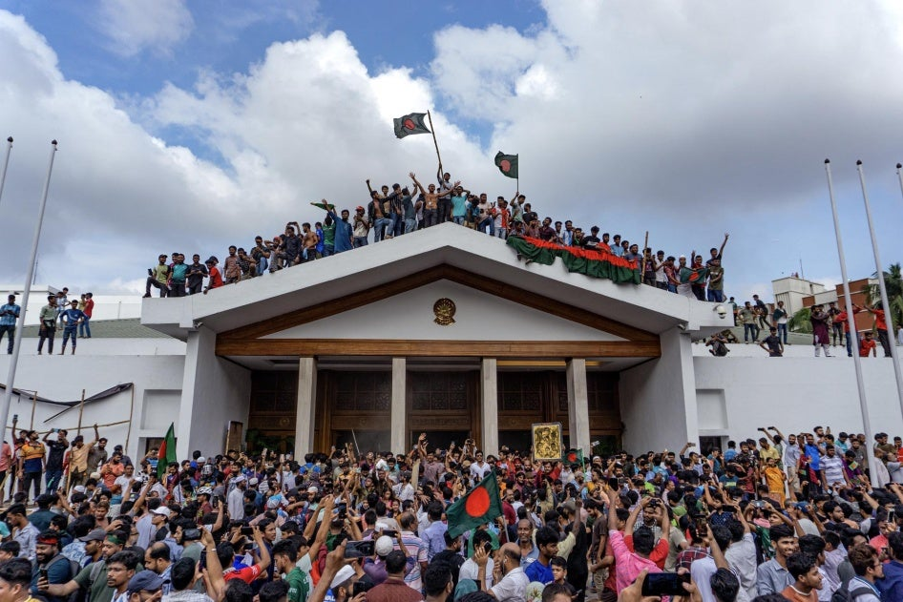
August 2025: The ‘monsoon revolution’
Students demanded fundamental reforms of key institutions to restore a sense of equality, justice and accountability in the society

Slide 7
The white paper on Bangladesh economy
‘Kleptocracy’ (White paper, GoB, 2024)
  16 billion dollars were illicitly siphoned off from Bangladesh every year between 2009-2024
  Banking sector most 'ravaged' by corruption
  Non-performing loans amounted to31.7% of total loans
    Window-dressed as ‘rescheduled’
  Loans advanced mostly on political considerations
  Creation of a syndicate

Slide 8
Role of the audit profession in a kleptocracy
The troubled banks mostly received unqualified reports (with some observations)
Raises serious questions regarding the role of the auditors
Further scrutiny reveals…
  Many auditors preferred not to audit banks due to fear of political influences
  Faced intimidation from the management of politically connected banks
  Auditors were regularly ‘instructed’ by the central bank to revise their NPL estimates downwards
  Central Bank plays an important role in the appointment of auditors
  Following the collapse of the regime, the governor also fled!

Slide 9
Bangladesh 2.0: expectations from the audit profession
Not a lot really!
Delivering accountability, restoring a sense of fairness: Back to the basics... ‘independence, objectivity, independence of thought’
Potential obstacles:
  Poor levels of corporate governance
    The questionable independence of ‘Independent’ directors
    Ineffective audit committees
  New Bangladesh, old regulators!
    Capacity
    Intention!

Slide 10
Way forward for the profession..
Lobby the government to carry out institutional reforms
  Creating a pool of independent directors
  Second tier accountancy profession
  Make FRC more professional
    Capacity development
    Appointment of professional accountants
    Independence from the government
Local problem requires local solution
  Consider potential regulatory protection of CFOs
  Collective action from ICAB

Slide 11
Way forward for the profession..
Reforms within the profession
  There is an appetite for reforms within the profession
  Ensure young chartered accountants can get to leadership positions
  Encourage more female students to join the profession
  Consider incorporating external experts in your committees
    Corporate leaders
    Academics
Visibility is the key!
  Present your observations on key economic issues (for example, the ongoing tariff challenge)
  Engage regularly with key stakeholder groups

Slide 12
Thank you!

